Slide 1

BHEL’s Gasification Experience
National Mineral Congress
27th May 2022

Slide 2

Index
BHEL’s Gasification Journey
BHEL‘s Coal to Methanol Demo plant - Recent Development
Introduction
BHEL’s Gasification and Integrated Offerings
Summary

Slide 3
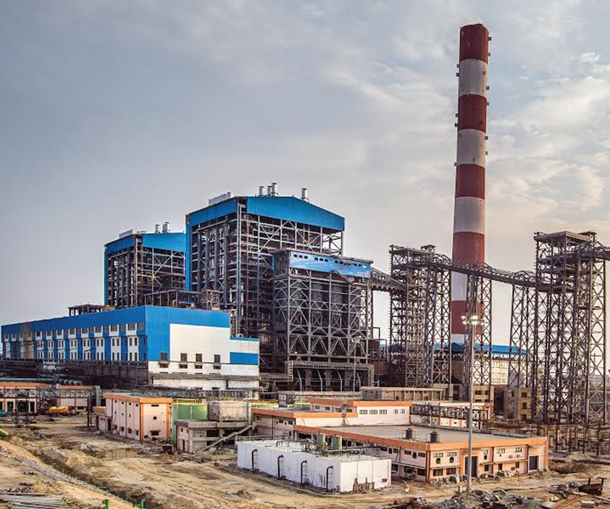
BHEL- An Overview
More than 193 GW of generating capacity commissioned in India and abroad, of which approx. 3/4th is thermal.
Successful transition in Indian thermal power sector from sub-critical to super critical and ultra super critical technologies.
Capability of executing projects on engineering, procurement & construction basis of various rating and plant capacities for customers in central, state and private sectors.
BHEL Trichy - pioneer in not only combustion technology for coal fired boilers, but also in indigenous gasifier technology for high ash Indian coal.
Substantial in-house R&D and design capabilities to support manufacturing and execution

Slide 4
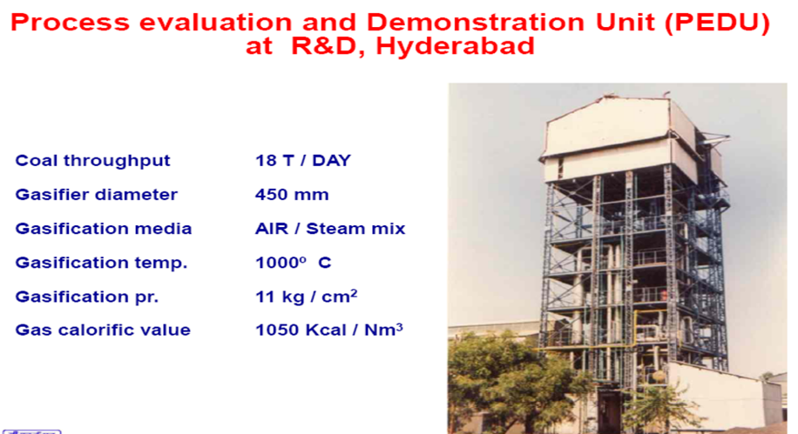
BHEL – Scale Up Events

Slide 5
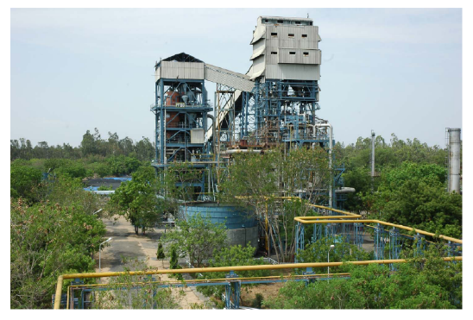
6.2 MW PFBG Plant at BHEL, Trichy
  SEED FUNDING USAID (PACER Prog.)
  CO-SPONSORS BHEL, PETC-USA
  COMMISSIONING 1997
OP PRES, TEMP 12 kg/cm²,1100 ᵒC
COAL 168 TPD
SYNGAS GENERATION 450 TPD
GAS CALORIFIC VALUE `1200 Kcal / Nm³

Slide 6
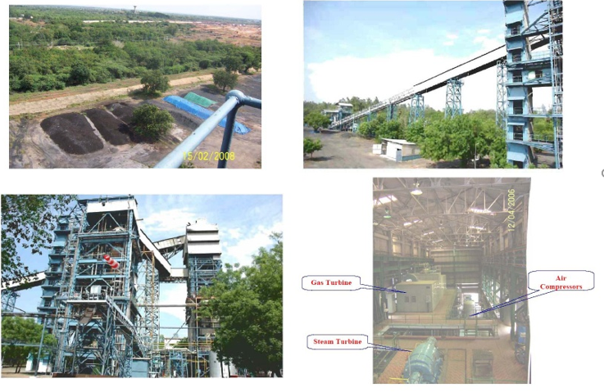
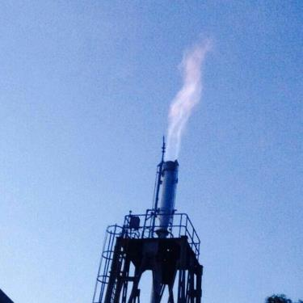
Bhel trichy - 6.2 MW IGCC PFBG PLANT

Slide 7
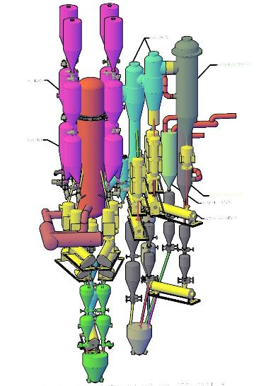
BHEL – Pressurized Fluidized Bed Gasifier
Coal Bin
Syngas Cooler
Coal Feeding Lock Hopper
Cyclone
PFBG Gasifier
Ash Cooler
Hot Air Generator
Ash Screw Conveyors
Bottom Ash Lock Hopoer

Slide 8
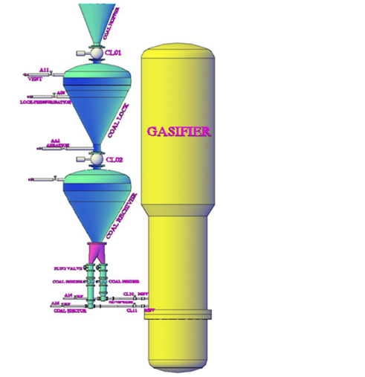
BHEL – Pressurized Fluidized Bed Gasifier
Crusher Sufficient
No Pulverized Fuel / Costly Feeding Equipment
Fluidized Bed Process
Wide Variety of Coal & Lignite
No Tar Formation
5 to 50% Ash
No Slagging
Dry Discharge System

Slide 9
BHEL – PFBG Operation at Trichy
PFBG operational summary
10000 HRS OF CUMULATIVE OPERATION
105 GASIFICATION RUNS
Indian Coal | % Range
Moisture | 5 – 10
Volatile Matter | 20 – 27
Ash | 20 – 45
Fixed Carbon | 36 – 42
HHV, kcal/Kg | 3000 – 4750
Syngas produced is supplied to HPBP Trichy HT furnaces on Continuous Basis establishing commercial campaign viability
PSA constituted national level R&D committee chaired by Dr. Sikka, Scientific Secretary to PSA in Nov 2002.
The committee participated in tests in CCDP, collected and analyzed the data
Committee recommended for setting up of a 100 MW Demo plant by BHEL& NTPC
DPR submitted in 2006 for demo plant at NTPC Auriya site
Technical & Commercial discussions held with APGENCO for 125 MW plant; later enhanced to 182 MW

Slide 10
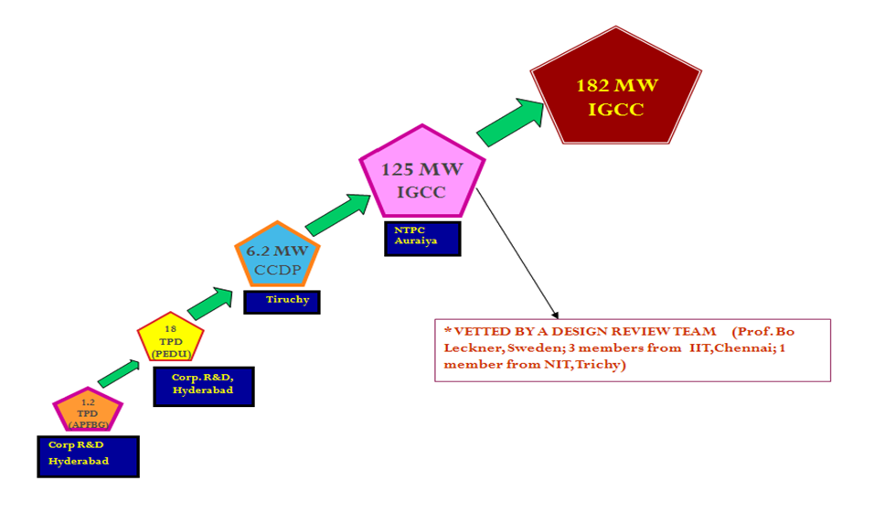
Capabilities of BHEL in Gasification
2600 TPD
2280 TPD
Single train gasifier
2008-10
168TPD
2004-06
1997
VETTED BY A DESIGN REVIEW TEAM
1992
0.25 TPD Methanol
Oxy-blown
2000

Slide 11
Gasification Based Power Plant - IGCC
Parameters | USC | AUSC | IGCC
Net Efficiency on LHV basis | 42% | 46% | 48%
Coal flow g/kW-hr | 550 | 500 | 480
CO₂ g/kW-hr | 790 | 720 | 690
Reduction in CO₂ emission | Base | 8.7% | 12.5%
NO_{x} (mg/Nm³) with SCR (without SCR) | 100 (300) | 100 (300) | Not required (100)
SO_{x} (mg/Nm³) with FGD (without FGD) | 100 (2200) | 100 (2200) | Not required (50)
Basis:3700 Kcal/kg GCV

Slide 12
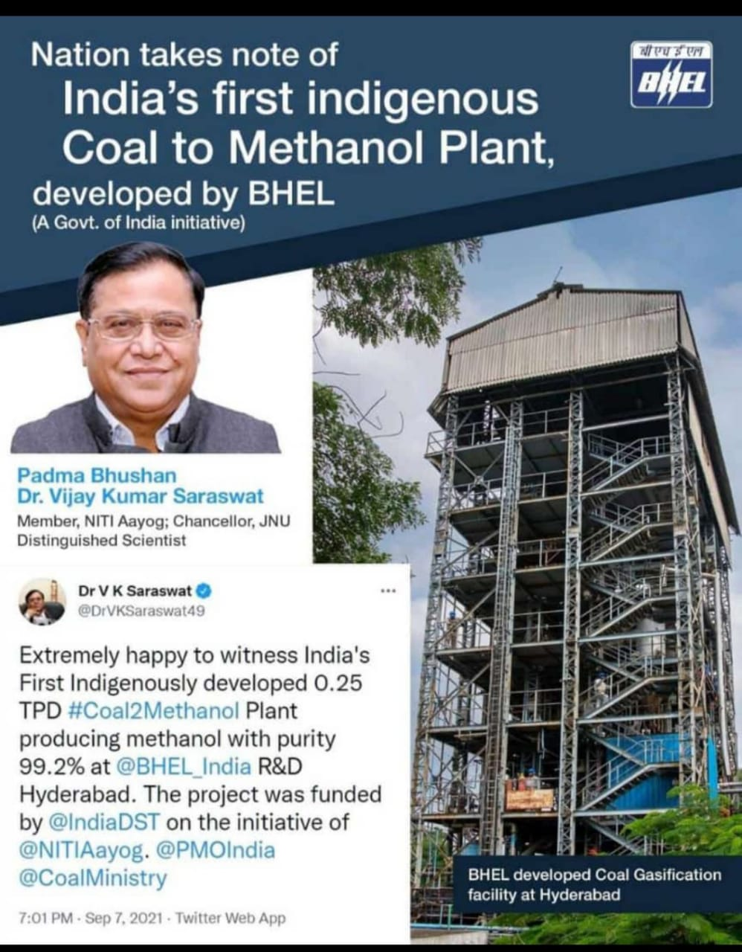
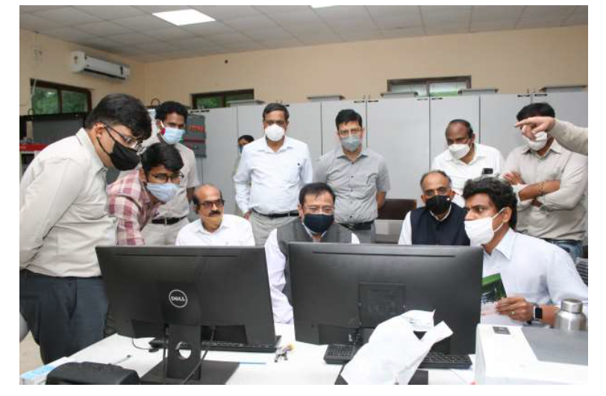
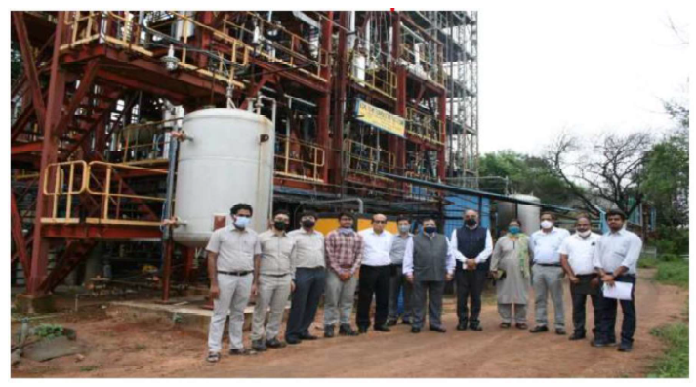
0.25 TPD Coal to Methanol Pilot Plant at BHEL Corporate R&D, Hyderabad

Slide 13
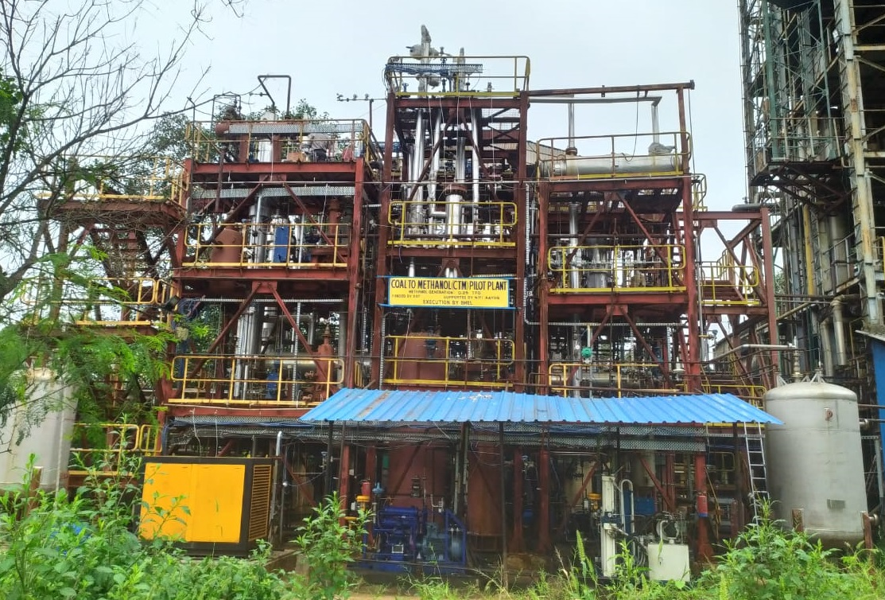
Coal To Methanol (CTM) Pilot plant view

Slide 14

BHEL’s Integrated Offerings
16 manufacturing facility across India & two engineering centres, R&D units
Erection & commissioning centres in four regions of country for EPC activities
Reference plants/equipment in refineries, fertilizer plants and other process industries.
Coal to Chemicals
Process Design | Gas Conditioning | Controls & Instrumentation
Gasifier Island , Gas cooling & Cleaning | Compressors, Pumps | Erection & Commissioning
Coal & Ash Handling | Cryogenic Oxygen Plant, Absorption & Stripper columns, Reactors | Balance of Plant
ALL major components of Coal to chemical plants can be manufactured by BHEL.

Slide 15
Summary
  BHEL has successfully developed fluidized bed gasification technology for high ash Indian Coal and also has got rich experience of CFB technology
Experience in the development & operation of a Demo 6.2 MW PFBG plant
Successful demonstration of 0.25 TPD coal to methanol plant at Corp R&D with indigenously developed oxyblown fluidized bed gasifier technology, first of its kind in India (DST funded project)
State of the art manufacturing units with capability and capacity for making all major components/systems of coal to methanol/chemicals plant

Slide 16


